Slide 1













N.B.K.R Institute Of science and technology
FLIGHT BOARDING SYSTEM
Team Project By:-SK.MUBARAK(24kb1a05hx)
SK.JAFAR(24kb1a05hn)
P.TEJA(24kb1a05ed)

Slide 2

Introductoin
"We've all experienced the sometimes stressful process of boarding a flight, often involving long lines and a general rush to find our seats. Now we're going to explore a more organized and considerate approach known as a Flight Boarding Priority System. This system strategically assigns different boarding priorities to specific groups of passengers, such as senior citizens, families, and even solo travelers, aiming to create a smoother and more efficient experience for everyone involved."

Slide 3
01.
Minimize boarding time and Improve passenger satisfaction
OBJECTIVES
02.
Enhance airport and airline efficiency.improve transport efficientcy
03.
Ensure fairness in the boarding process and less time manegement

Slide 4
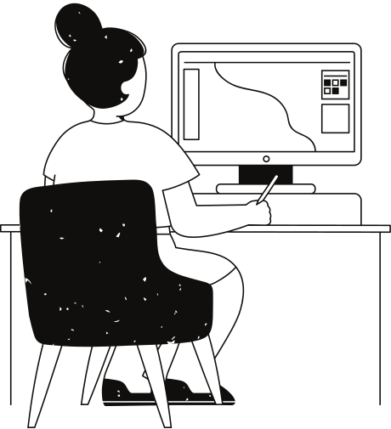
ALGORITHM
Step 1: Categorize Passengers and Create Queues
* Action: Define distinct priority groups for boarding (e.g., First Class, Business, Frequent Flyers, Economy). For each priority group, create a separate queue data structur
Step 2: Assign Passengers to Their Respective Queues
* Action: As passengers become ready to board (e.g., during check-in or at the gate), determine their boarding priority. Enqueue each passenger into the corresponding priority queue based on this determination.
Step 3: Establish the Boarding Order
* Action: Determine the order in which the priority queues will be processed for boarding. This is typically from the highest priority group to the lowest (e.g., First Class first, then Business, and so on).
Step 4: Board Passengers Based on Priority
* Action: Iterate through the priority queues in the established boarding order (from Step 3). For each queue, process the passengers in a First-In, First-Out (FIFO) manner (by dequeuing them) until the current queue is empty.
Step 5: Repeat Until All Passengers Are Boarded
* Action: Continue processing each priority queue in the defined order until all queues are empty, indicating that all passengers have boarded the flight.

Slide 5
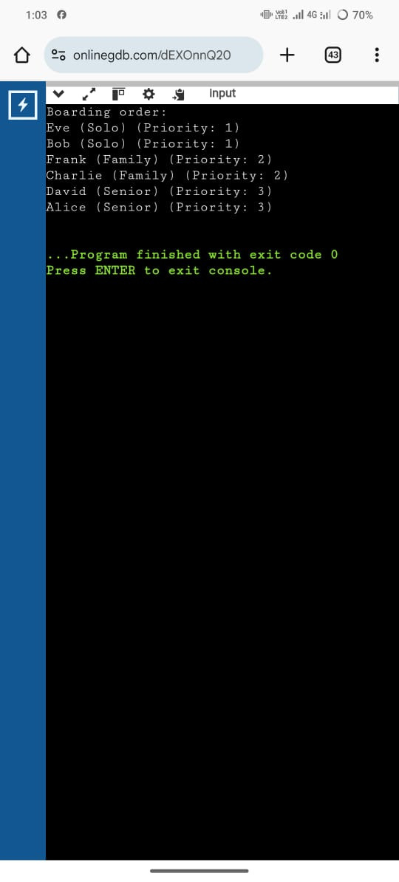
SOURCE CODE AND OUT PUT
https://onlinegdb.com/dEXOnnQ20

Slide 6

CONCLUSION
Implementing flight boarding priority offers a structured approach.Using a priority queue organizes boarding for a smoother flow.This system aims for a less stressful and potentially faster experience for all.

Slide 7
Thank you very much!

